Slide 1
Title : Artifactory
Authored and Presented by : Vijeta Angeer

Slide 2
Agenda
What is Artifactory?
Why Artifactory?
Artifactory Architecture
Difference between Artifactory and nexus ?
Features of Artifactory
Different repositories
Integration with Atlassian tools and other tools
Migration from Nexus to Artifactory

Slide 3
What is Artifactory?
Its an advanced binaries repository manager- the binaries SCM
Artifactory acts as a proxy between your build tool (Maven, Ant, Ivy, Gradle etc.) and the outside world.
It caches remote artifacts so that you don’t have to download them over and over again.
First “real” web-driven repository manager (2006)
You can gain full control over all the build artifacts and third-party dependencies your organization uses.
Critical for CI/CD and ALM

Slide 4
Why Artifactory?
Open Source project.
Its an repository manager
- Artifacts storage and proxy
- Avoid hitting public remote repositories
- Inefficient, unreliable, content quality, non-secure...
- Deploy, manage and share local artifacts
- Full control over artifacts resolution and delivery
Integrate with any build tool- Maven, Gradle, Ivy and more.
Deploy through industry standard CI servers-Jenkins, TeamCity, Bamboo and more. Even cloud-based CI servers are supported.

Slide 5
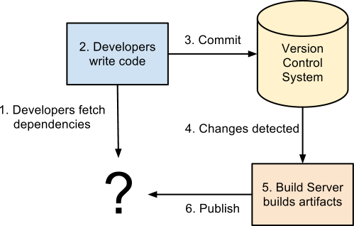
Why Artifactory-Cont…

Slide 6
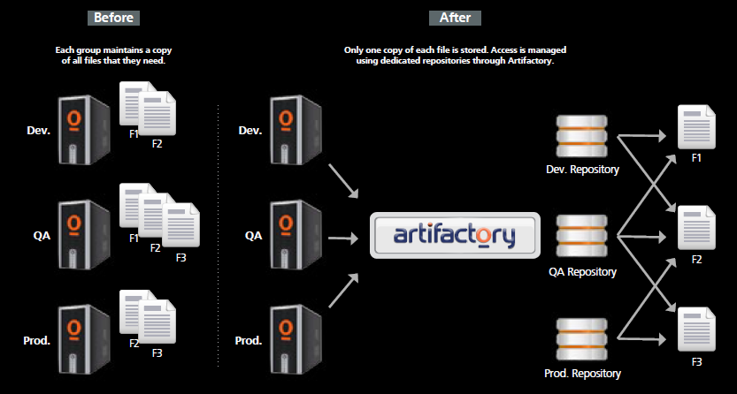
Why Artifactory-Cont…

Slide 7
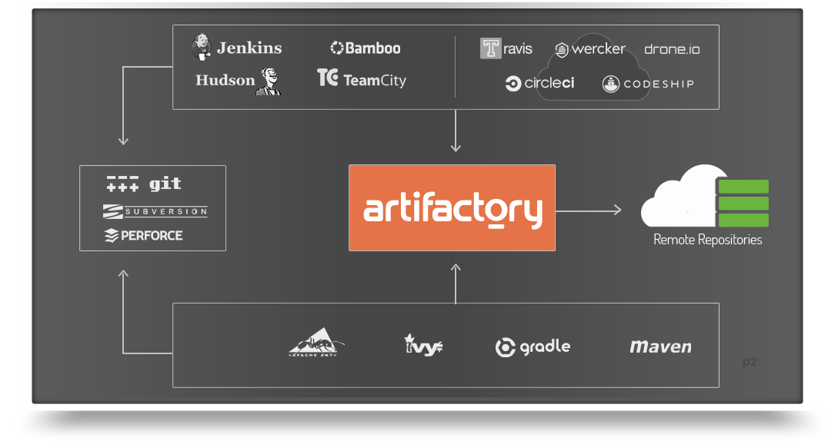
Artifactory Architecture
Robust Architecture
Built on top of the Java Content Repository (JCR), Artifactory offers higher concurrency and unmatched data integrity.
When run on top of MySQL Artifactory can support an amazingly high volume of concurrent downloads and deployments.

Slide 8
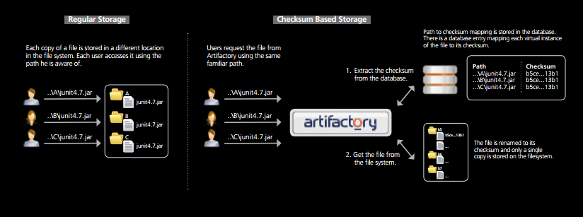
Artifactory Architecture – Cont …

Slide 9
Artifactory Vs Nexus
 | Artifactory | Nexus
Cloud-based SaaS | Private Artifactory instance in the cloud with full self service. | Not supported
Auto-cleanup of repositories declared in POMs | Can remove problematic external repository declarations in POMs exposed via virtual repositories. | Nexus does not manipulate poms that it proxies.
Eager parallel download of related artifacts | Can download jars in parallel. | Not supported
Shared Remote Repository Definitions | import preconfigured definitions for most common remote repositories, save the configuration hassle. | Not supported
Search for non-Maven artifacts | Indexes any file in any format | Relies on maven-indexer which only indexes artifacts in Maven format
Search for artifacts in Bintray JCenter | Supported | Not supported

Slide 10
Artifactory Vs Nexus - Cont.….
 | Artifactory | Nexus
Proxy remote metadata | Metadata for remote artifacts on another Artifactory is synced and proxied. | Not Supported
Multiple CI servers support | Supports all CI server with full UI integration. | Not Supported
Trace published build artifacts and dependencies. | Captures all published artifacts and effective build dependencies . | Not Supported
Bi-directional links from/to CI sever | Can link from any build to its captured build info in Artifactory and from any artifact to the builds it is associated with in the CI server. | Not Supported
CI-Build Promotion | Can promote CI builds to target repositories with selective scopes) Also via REST (Pro). | Not Supported
Cost Each CI server agent and build tool considered a "user" | US$2,750 for unlimited users with Artifactory Pro | US$10,200 for 100 users included with Nexus Pro All with unlimited servers.

Slide 11
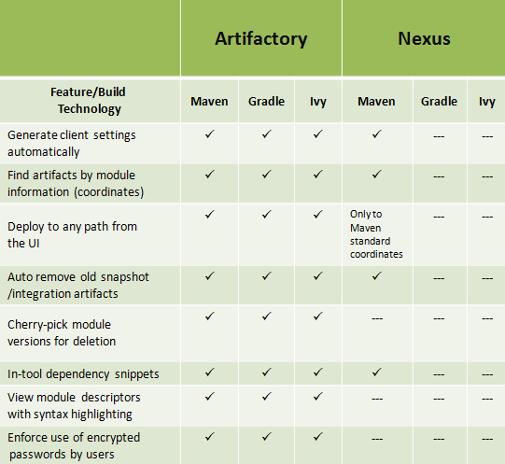
Artifactory Vs Nexus - Cont.….

Slide 12
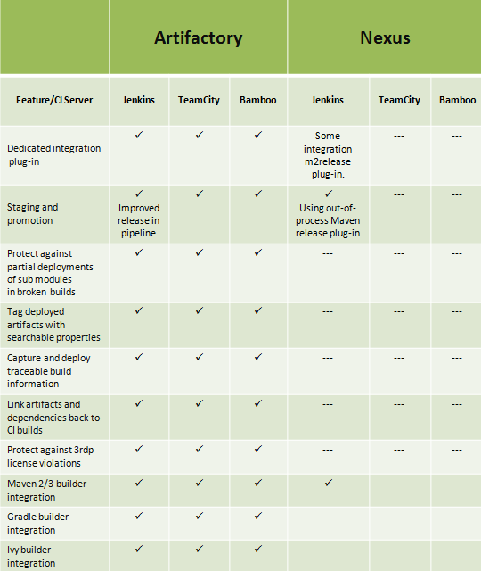
Artifactory Vs Nexus - Cont.….

Slide 13
Features of Artifactory
Supports p2 eclipse plugin repository,nugget,gradle,ivy,npm,yum and many more
Supports Crowd SSO, LDAP integration, JIRA issue integration.
Watchers, Good UI to manage Administrative part and permissions
Upload artifacts from UI
Automatically generate client configurations
Supports build promotion, after build promotion update the version in pom.xml
Manages in-house Docker containers.
Store build data, which helps in traceability.

Slide 14
Artifactory Repositories
Artifactory hosts three types of repository:
Local
Remote
Virtual
Local and remote repositories are true physical repositories.
While a virtual repository is actually an aggregation of them used
to create controlled domains for search and resolution of artifacts.
To configure repositories, in the Admin tab, go to Configuration | Repositories.
Repositories can be created, deleted, edited, ordered and aggregated.

Slide 15
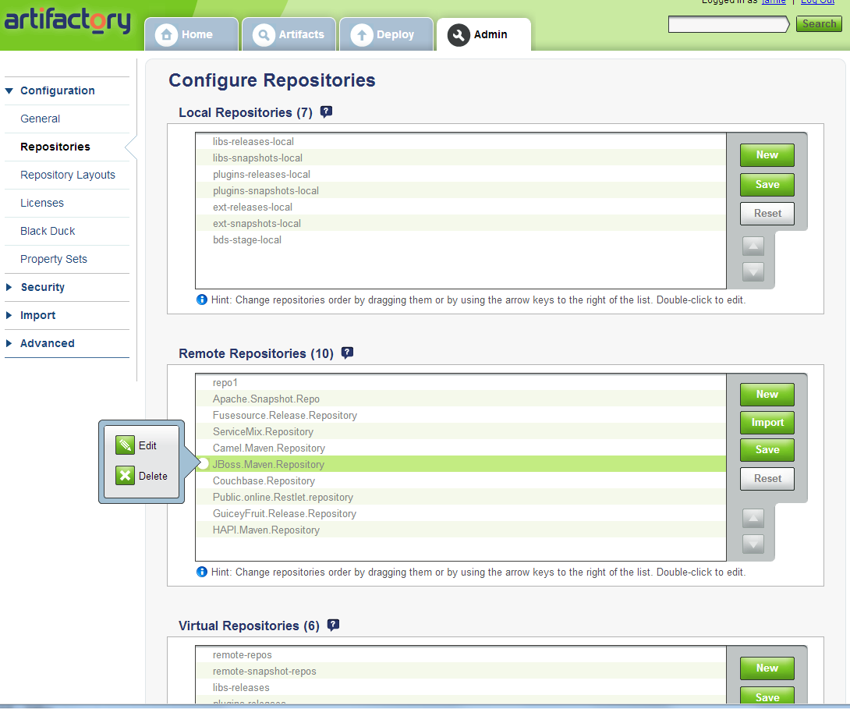
Artifactory Repositories – Cont …

Slide 16
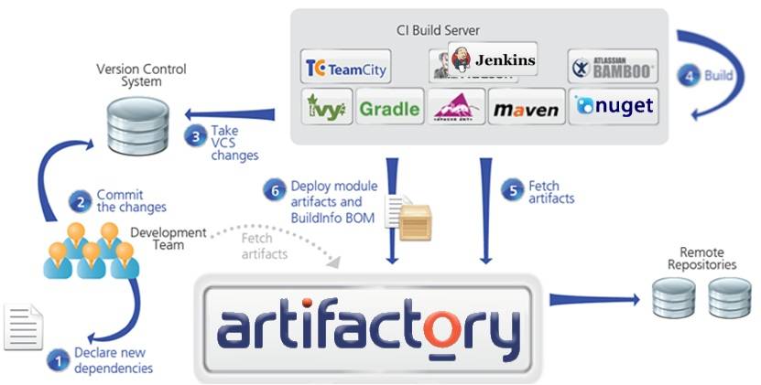
Artifactory With DevOps and Ecosystem

Slide 17
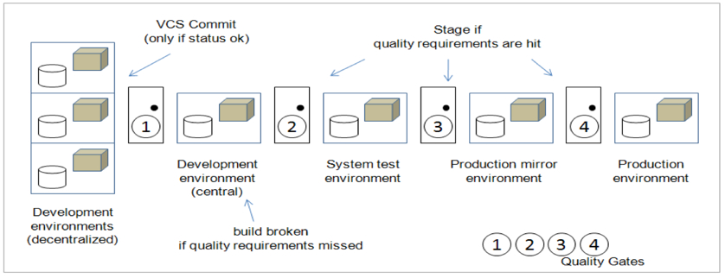

Release Pipeline

Slide 18
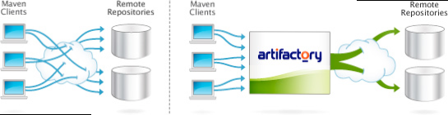
Artifactory Integration With Maven
Artifactory supports working with Maven both as
- a source for artifacts needed for a build,
- and as a target to deploy artifacts generated in the build process.
Maven is configured using a settings.xml file located under your Maven home directory.

Slide 19


Artifactory and Jenkins
Artifactory and Jenkins
Deploy from Hudson to Artifactory
Navigate the builds in Artifactory
Link back to Hudson builds
Relate artifacts to build
Export/promote/manipulate build artifacts
More efficient multi-module deployment

Slide 20
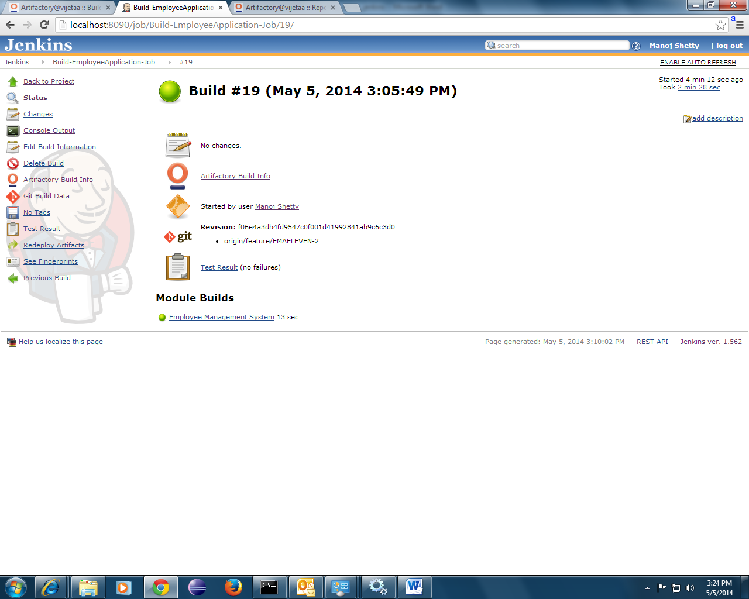
Artifactory and Jenkins – Cont…

Slide 21
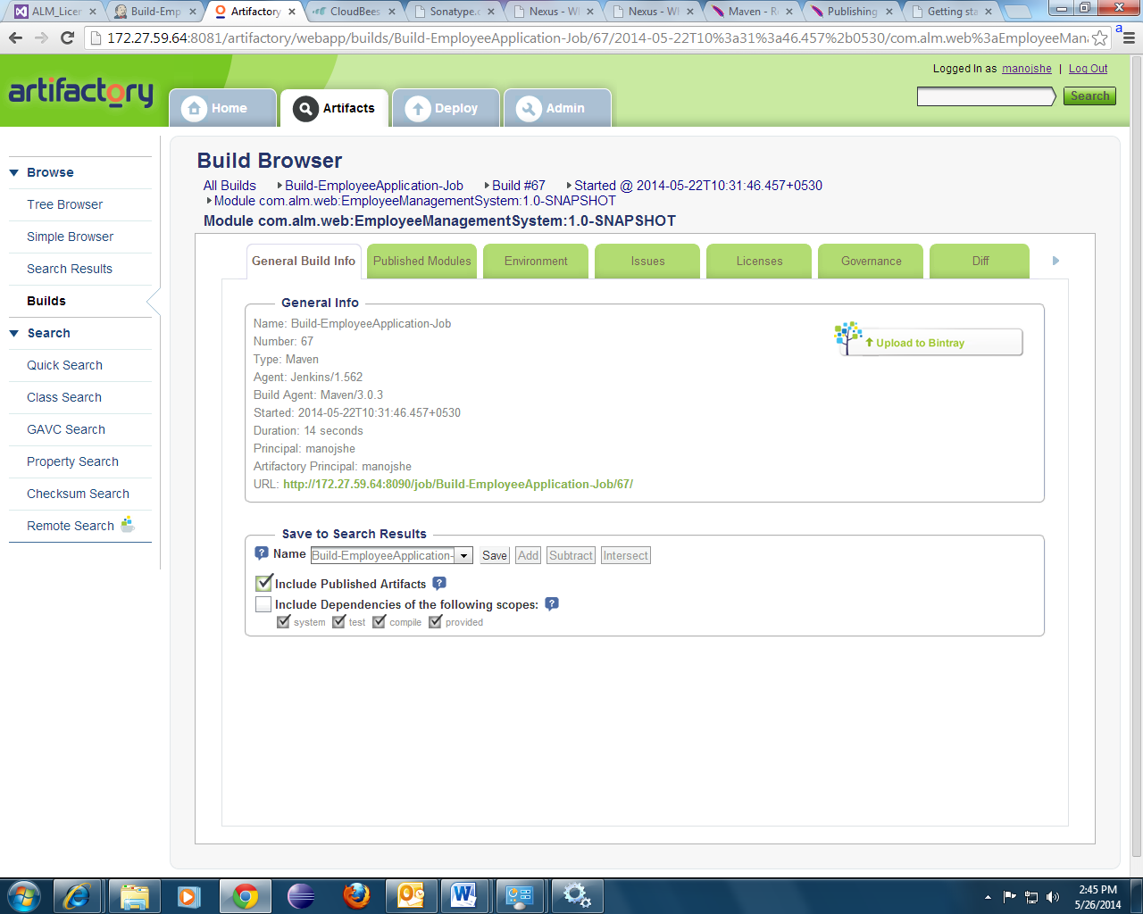
Artifactory and Jenkins – Cont…

Slide 22
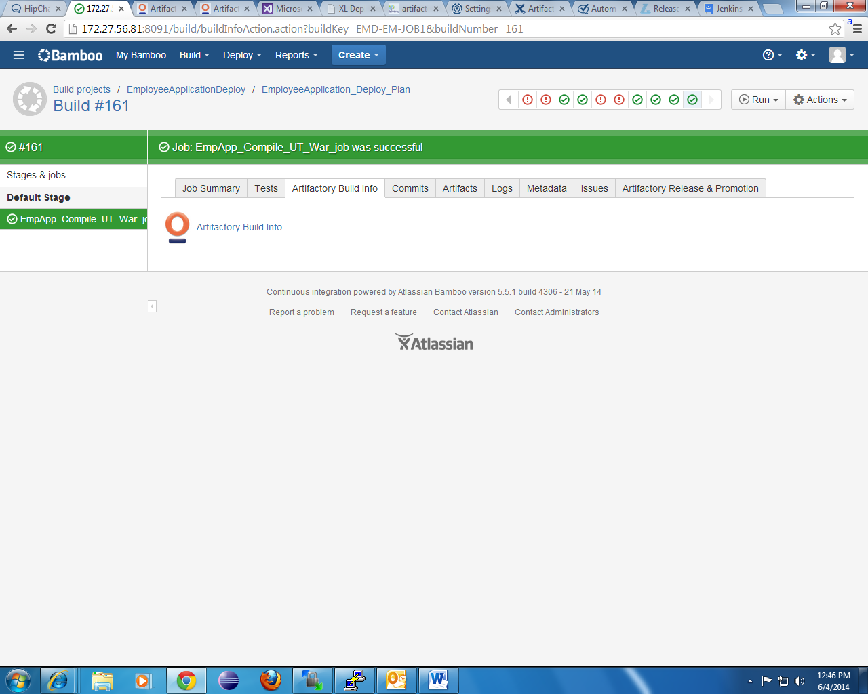
Artifactory and Bamboo

Slide 23
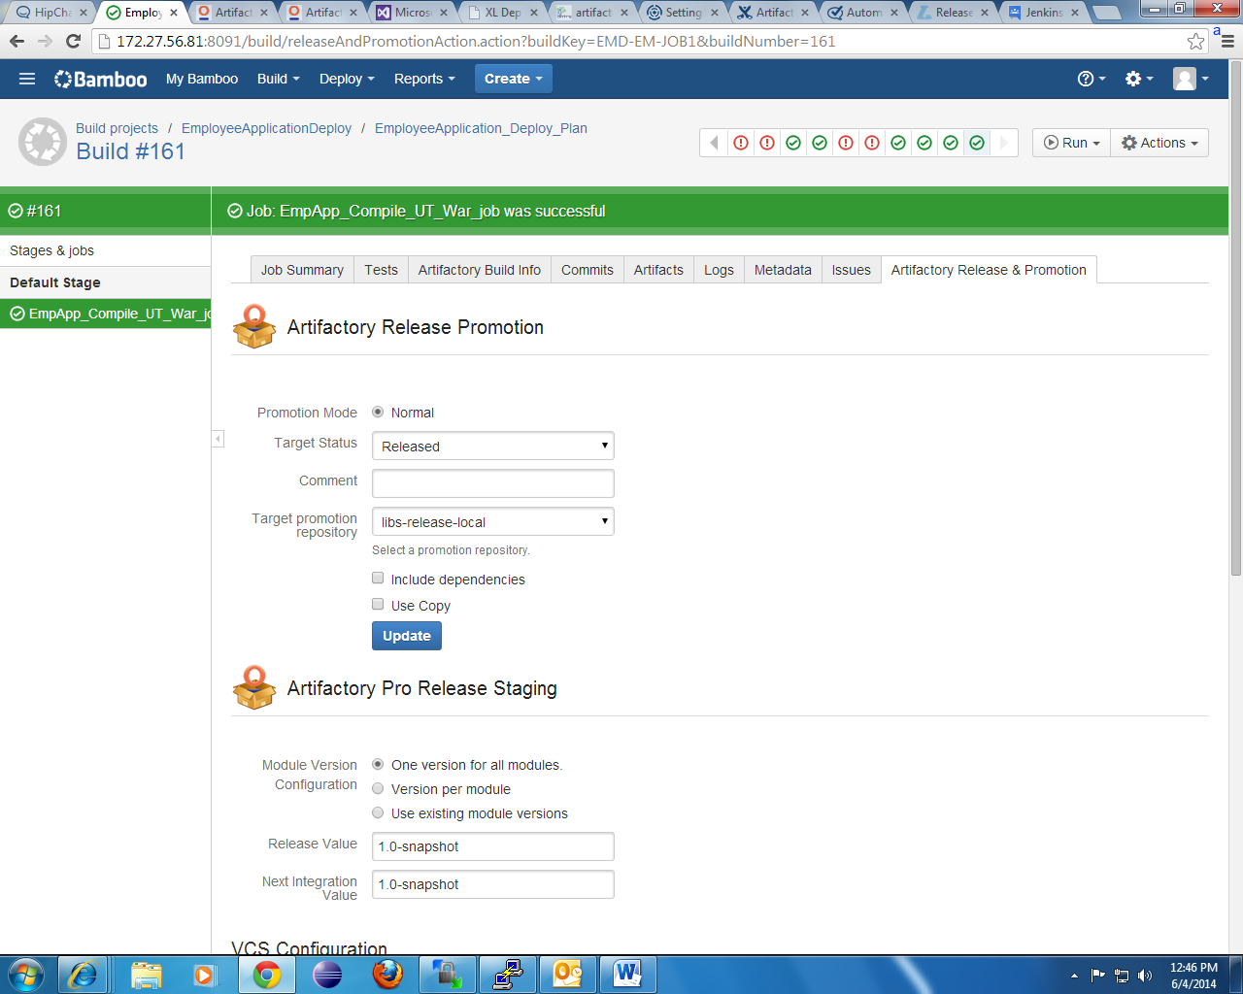
Artifactory and Bamboo – Cont …

Slide 24
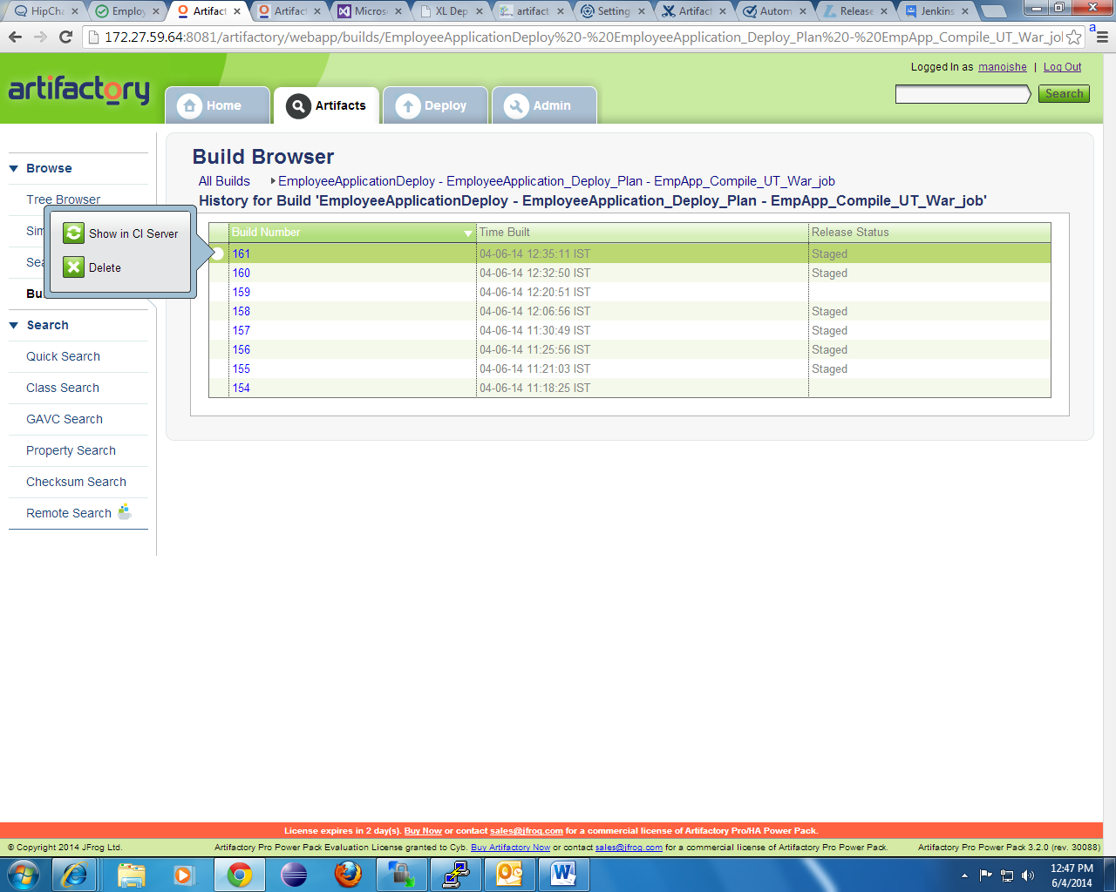
Artifactory and Bamboo – Cont …

Slide 25
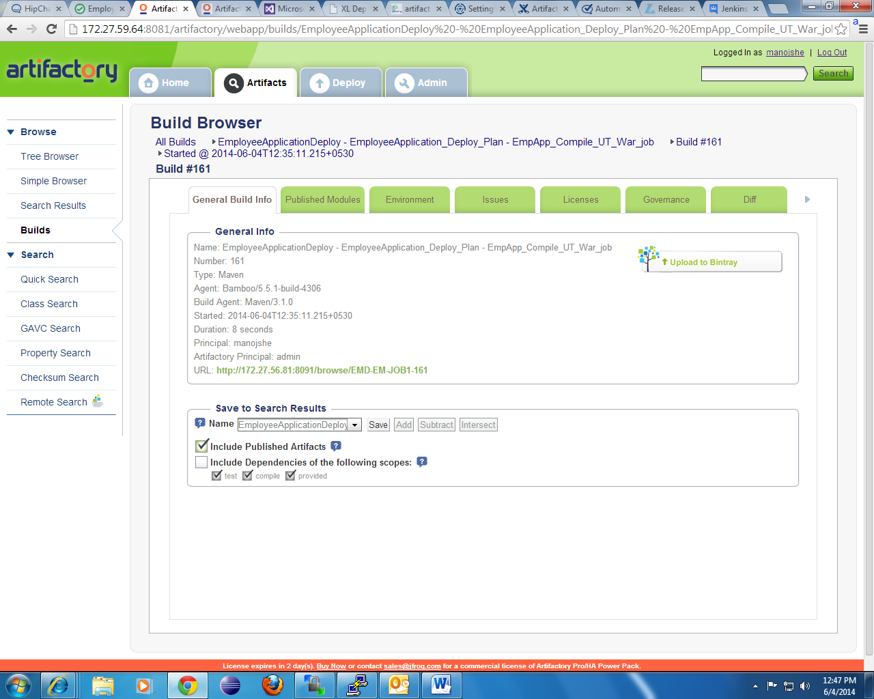
Artifactory and Bamboo – Cont …

Slide 26
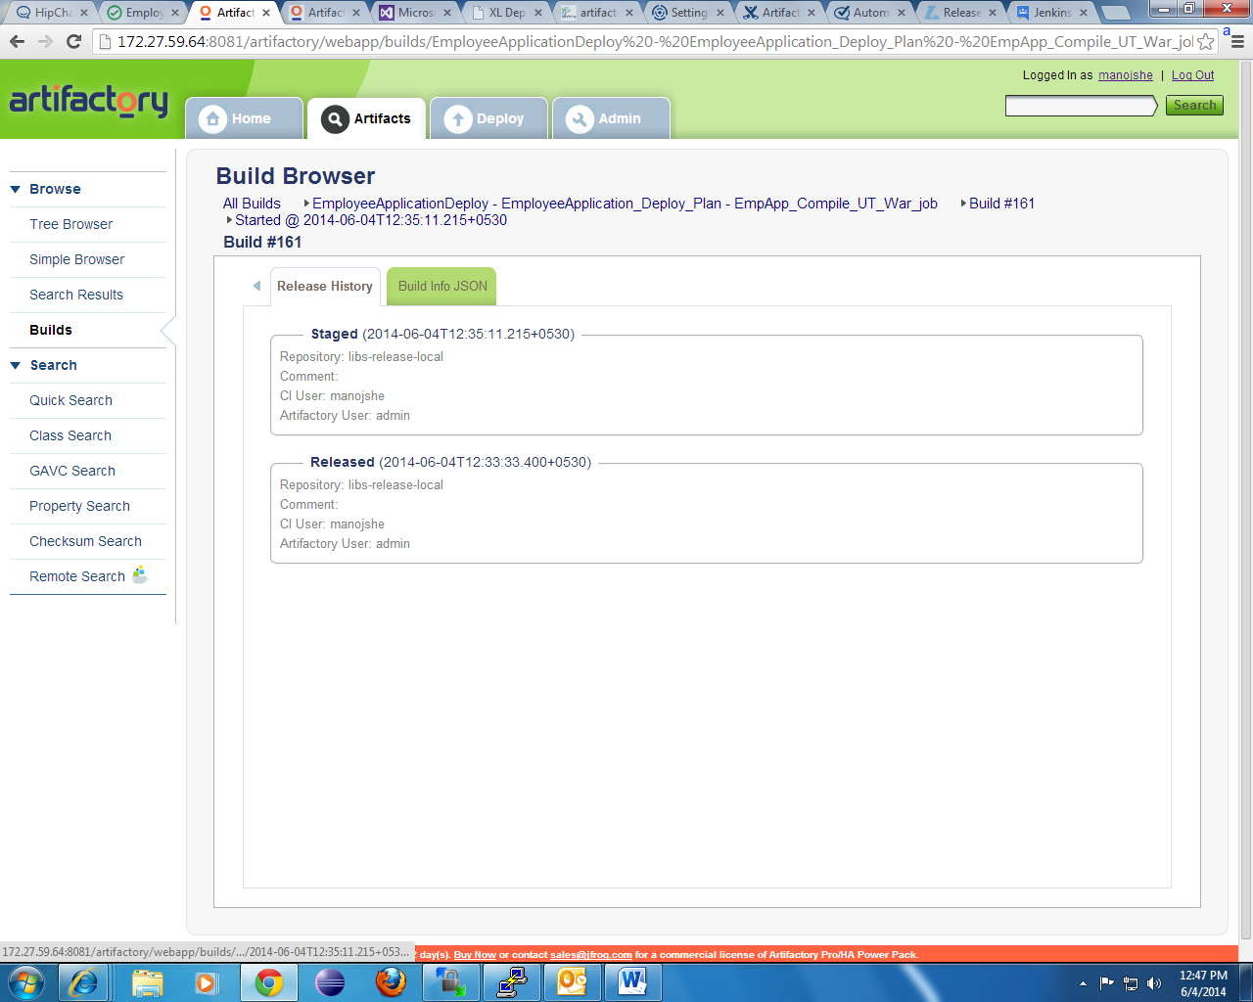
Artifactory and Bamboo – Cont …

Slide 27
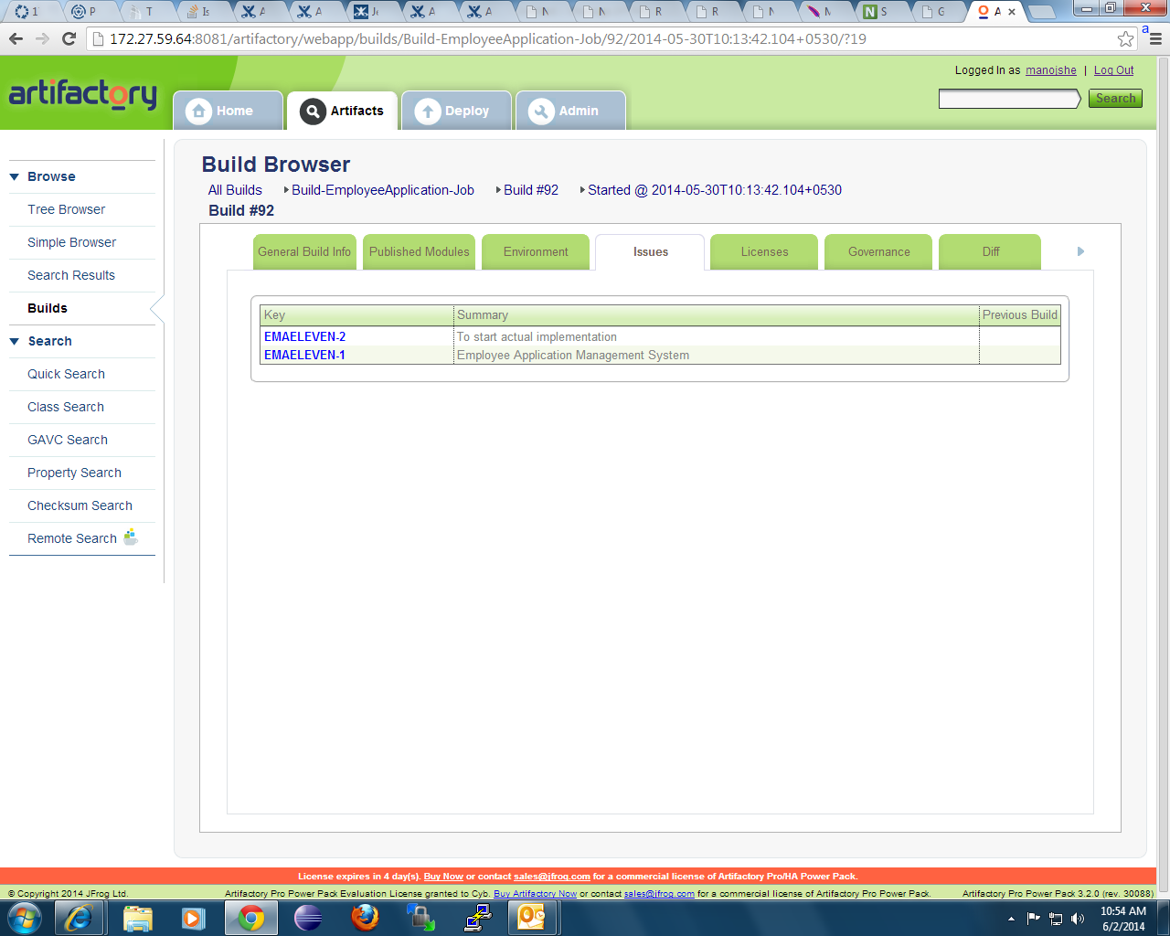
Artifactory and JIRA

Slide 28
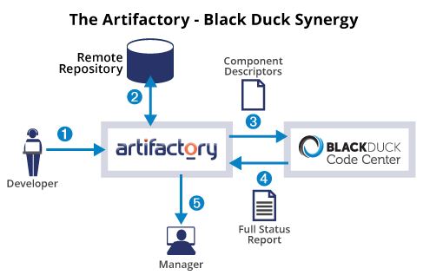
Artifactory with Black Duck

Slide 29
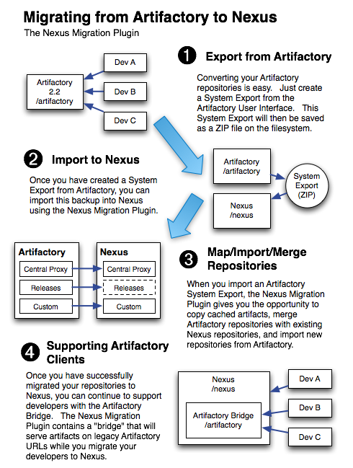
Migration from Nexus To Artifactory

Slide 30
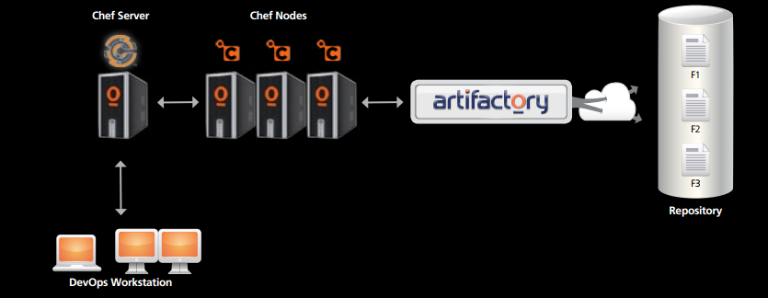
Artifactory With DevOps - Chef

Slide 31
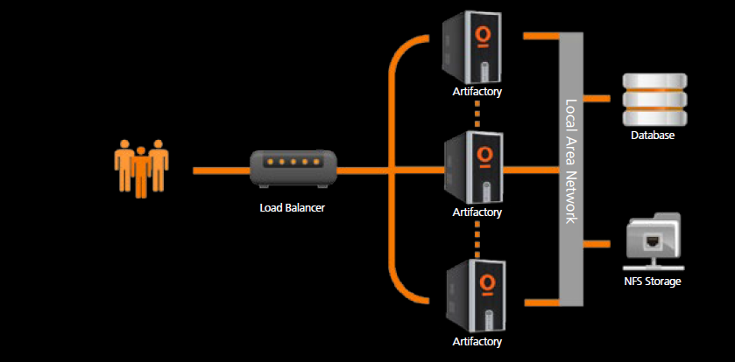
Artifactory With DevOps – High Availability

Slide 32
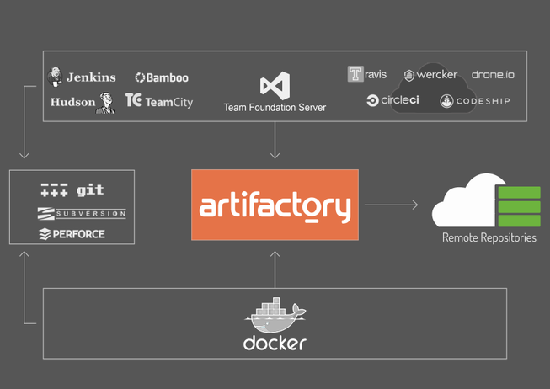
Artifactory With Docker– High Availability
Put it in a container and ship it with Artifactory

Slide 33

Any Questions?

Slide 34
Thank You!

